Slide 1

VISUAL REASONING
MIRROR IMAGE
In this question you are given a combination of alphabets and/or numbers followed by four alternatives (1), (2), (3) and (4). Choose the alternative which is closely resembles the mirror image of the given combination.
Q 1.

Slide 2
VISUAL REASONING
MIRROR IMAGE
In this question you are given a combination of alphabets and/or numbers followed by four alternatives (1), (2), (3) and (4). Choose the alternative which is closely resembles the mirror image of the given combination.
Q 1.

Slide 3

VISUAL REASONING
MIRROR IMAGE
In this question you are given a combination of alphabets and/or numbers followed by four alternatives (1), (2), (3) and (4). Choose the alternative which is closely resembles the mirror image of the given combination.
Q 2.

Slide 4
VISUAL REASONING
MIRROR IMAGE
In this question you are given a combination of alphabets and/or numbers followed by four alternatives (1), (2), (3) and (4). Choose the alternative which is closely resembles the mirror image of the given combination.
Q 2.

Slide 5
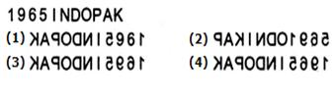
VISUAL REASONING
MIRROR IMAGE
In this question you are given a combination of alphabets and/or numbers followed by four alternatives (1), (2), (3) and (4). Choose the alternative which is closely resembles the mirror image of the given combination.
Q 3.

Slide 6
VISUAL REASONING
MIRROR IMAGE
In this question you are given a combination of alphabets and/or numbers followed by four alternatives (1), (2), (3) and (4). Choose the alternative which is closely resembles the mirror image of the given combination.
Q 3.

Slide 7
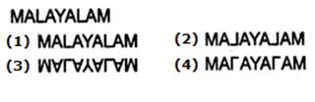
VISUAL REASONING
MIRROR IMAGE
In this question you are given a combination of alphabets and/or numbers followed by four alternatives (1), (2), (3) and (4). Choose the alternative which is closely resembles the mirror image of the given combination.
Q 4.

Slide 8
VISUAL REASONING
MIRROR IMAGE
In this question you are given a combination of alphabets and/or numbers followed by four alternatives (1), (2), (3) and (4). Choose the alternative which is closely resembles the mirror image of the given combination.
Q 4.

Slide 9
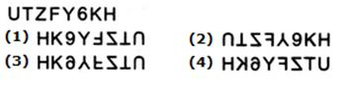
VISUAL REASONING
MIRROR IMAGE
In this question you are given a combination of alphabets and/or numbers followed by four alternatives (1), (2), (3) and (4). Choose the alternative which is closely resembles the mirror image of the given combination.
Q 5.

Slide 10
VISUAL REASONING
MIRROR IMAGE
In this question you are given a combination of alphabets and/or numbers followed by four alternatives (1), (2), (3) and (4). Choose the alternative which is closely resembles the mirror image of the given combination.
Q 5.

Slide 11
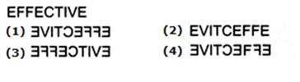
VISUAL REASONING
MIRROR IMAGE
In this question you are given a combination of alphabets and/or numbers followed by four alternatives (1), (2), (3) and (4). Choose the alternative which is closely resembles the mirror image of the given combination.
Q 6.

Slide 12
VISUAL REASONING
MIRROR IMAGE
In this question you are given a combination of alphabets and/or numbers followed by four alternatives (1), (2), (3) and (4). Choose the alternative which is closely resembles the mirror image of the given combination.
Q 6.

Slide 13
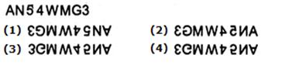
VISUAL REASONING
MIRROR IMAGE
In this question you are given a combination of alphabets and/or numbers followed by four alternatives (1), (2), (3) and (4). Choose the alternative which is closely resembles the mirror image of the given combination.
Q 7.

Slide 14
VISUAL REASONING
MIRROR IMAGE
In this question you are given a combination of alphabets and/or numbers followed by four alternatives (1), (2), (3) and (4). Choose the alternative which is closely resembles the mirror image of the given combination.
Q 7.

Slide 15
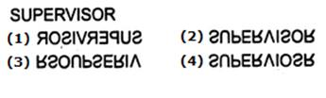
VISUAL REASONING
MIRROR IMAGE
In this question you are given a combination of alphabets and/or numbers followed by four alternatives (1), (2), (3) and (4). Choose the alternative which is closely resembles the mirror image of the given combination.
Q 8.

Slide 16
VISUAL REASONING
MIRROR IMAGE
In this question you are given a combination of alphabets and/or numbers followed by four alternatives (1), (2), (3) and (4). Choose the alternative which is closely resembles the mirror image of the given combination.
Q 8.

Slide 17
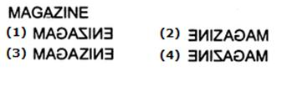
VISUAL REASONING
MIRROR IMAGE
In this question you are given a combination of alphabets and/or numbers followed by four alternatives (1), (2), (3) and (4). Choose the alternative which is closely resembles the mirror image of the given combination.
Q 9.

Slide 18
VISUAL REASONING
MIRROR IMAGE
In this question you are given a combination of alphabets and/or numbers followed by four alternatives (1), (2), (3) and (4). Choose the alternative which is closely resembles the mirror image of the given combination.
Q 9.

Slide 19

VISUAL REASONING
MIRROR IMAGE
In this question you are given a combination of alphabets and/or numbers followed by four alternatives (1), (2), (3) and (4). Choose the alternative which is closely resembles the mirror image of the given combination.
Q 10.

Slide 20
VISUAL REASONING
MIRROR IMAGE
In this question you are given a combination of alphabets and/or numbers followed by four alternatives (1), (2), (3) and (4). Choose the alternative which is closely resembles the mirror image of the given combination.
Q 10.

Slide 21

VISUAL REASONING
MIRROR IMAGE
In this question you are given a combination of alphabets and/or numbers followed by four alternatives (1), (2), (3) and (4). Choose the alternative which is closely resembles the mirror image of the given combination.
Q 11.

Slide 22
VISUAL REASONING
MIRROR IMAGE
In this question you are given a combination of alphabets and/or numbers followed by four alternatives (1), (2), (3) and (4). Choose the alternative which is closely resembles the mirror image of the given combination.
Q 11.

Slide 23
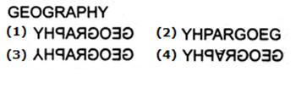
VISUAL REASONING
MIRROR IMAGE
In this question you are given a combination of alphabets and/or numbers followed by four alternatives (1), (2), (3) and (4). Choose the alternative which is closely resembles the mirror image of the given combination.
Q 12.

Slide 24
VISUAL REASONING
MIRROR IMAGE
In this question you are given a combination of alphabets and/or numbers followed by four alternatives (1), (2), (3) and (4). Choose the alternative which is closely resembles the mirror image of the given combination.
Q 12.

Slide 25
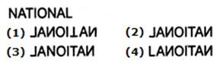
VISUAL REASONING
MIRROR IMAGE
In this question you are given a combination of alphabets and/or numbers followed by four alternatives (1), (2), (3) and (4). Choose the alternative which is closely resembles the mirror image of the given combination.
Q 13.

Slide 26
VISUAL REASONING
MIRROR IMAGE
In this question you are given a combination of alphabets and/or numbers followed by four alternatives (1), (2), (3) and (4). Choose the alternative which is closely resembles the mirror image of the given combination.
Q 13.

Slide 27
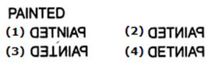
VISUAL REASONING
MIRROR IMAGE
In this question you are given a combination of alphabets and/or numbers followed by four alternatives (1), (2), (3) and (4). Choose the alternative which is closely resembles the mirror image of the given combination.
Q 14.

Slide 28
VISUAL REASONING
MIRROR IMAGE
In this question you are given a combination of alphabets and/or numbers followed by four alternatives (1), (2), (3) and (4). Choose the alternative which is closely resembles the mirror image of the given combination.
Q 14.

Slide 29
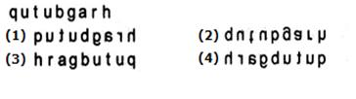
VISUAL REASONING
MIRROR IMAGE
In this question you are given a combination of alphabets and/or numbers followed by four alternatives (1), (2), (3) and (4). Choose the alternative which is closely resembles the mirror image of the given combination.
Q 15.

Slide 30
VISUAL REASONING
MIRROR IMAGE
In this question you are given a combination of alphabets and/or numbers followed by four alternatives (1), (2), (3) and (4). Choose the alternative which is closely resembles the mirror image of the given combination.
Q 15.

Slide 31
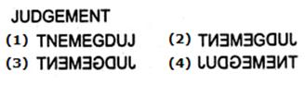
VISUAL REASONING
MIRROR IMAGE
In this question you are given a combination of alphabets and/or numbers followed by four alternatives (1), (2), (3) and (4). Choose the alternative which is closely resembles the mirror image of the given combination.
Q 16.

Slide 32
VISUAL REASONING
MIRROR IMAGE
In this question you are given a combination of alphabets and/or numbers followed by four alternatives (1), (2), (3) and (4). Choose the alternative which is closely resembles the mirror image of the given combination.
Q 16.

Slide 33
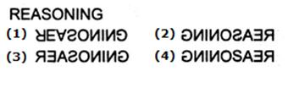
VISUAL REASONING
MIRROR IMAGE
In this question you are given a combination of alphabets and/or numbers followed by four alternatives (1), (2), (3) and (4). Choose the alternative which is closely resembles the mirror image of the given combination.
Q 17.

Slide 34
VISUAL REASONING
MIRROR IMAGE
In this question you are given a combination of alphabets and/or numbers followed by four alternatives (1), (2), (3) and (4). Choose the alternative which is closely resembles the mirror image of the given combination.
Q 17.

Slide 35
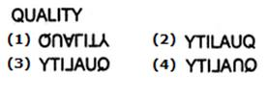
VISUAL REASONING
MIRROR IMAGE
In this question you are given a combination of alphabets and/or numbers followed by four alternatives (1), (2), (3) and (4). Choose the alternative which is closely resembles the mirror image of the given combination.
Q 18.

Slide 36
VISUAL REASONING
MIRROR IMAGE
In this question you are given a combination of alphabets and/or numbers followed by four alternatives (1), (2), (3) and (4). Choose the alternative which is closely resembles the mirror image of the given combination.
Q 18.

Slide 37
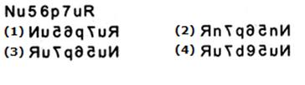
VISUAL REASONING
MIRROR IMAGE
In this question you are given a combination of alphabets and/or numbers followed by four alternatives (1), (2), (3) and (4). Choose the alternative which is closely resembles the mirror image of the given combination.
Q 19.

Slide 38
VISUAL REASONING
MIRROR IMAGE
In this question you are given a combination of alphabets and/or numbers followed by four alternatives (1), (2), (3) and (4). Choose the alternative which is closely resembles the mirror image of the given combination.
Q 19.

Slide 39
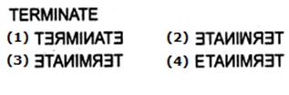
VISUAL REASONING
MIRROR IMAGE
In this question you are given a combination of alphabets and/or numbers followed by four alternatives (1), (2), (3) and (4). Choose the alternative which is closely resembles the mirror image of the given combination.
Q 20.

Slide 40
VISUAL REASONING
MIRROR IMAGE
In this question you are given a combination of alphabets and/or numbers followed by four alternatives (1), (2), (3) and (4). Choose the alternative which is closely resembles the mirror image of the given combination.
Q 20.

Slide 41
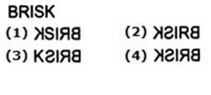
VISUAL REASONING
MIRROR IMAGE
In this question you are given a combination of alphabets and/or numbers followed by four alternatives (1), (2), (3) and (4). Choose the alternative which is closely resembles the mirror image of the given combination.
Q 21.

Slide 42
VISUAL REASONING
MIRROR IMAGE
In this question you are given a combination of alphabets and/or numbers followed by four alternatives (1), (2), (3) and (4). Choose the alternative which is closely resembles the mirror image of the given combination.
Q 21.

Slide 43

VISUAL REASONING
MIRROR IMAGE
In this question you are given a combination of alphabets and/or numbers followed by four alternatives (1), (2), (3) and (4). Choose the alternative which is closely resembles the mirror image of the given combination.
Q 22.

Slide 44
VISUAL REASONING
MIRROR IMAGE
In this question you are given a combination of alphabets and/or numbers followed by four alternatives (1), (2), (3) and (4). Choose the alternative which is closely resembles the mirror image of the given combination.
Q 22.

Slide 45
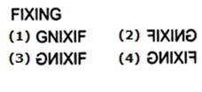
VISUAL REASONING
MIRROR IMAGE
In this question you are given a combination of alphabets and/or numbers followed by four alternatives (1), (2), (3) and (4). Choose the alternative which is closely resembles the mirror image of the given combination.
Q 23.

Slide 46
VISUAL REASONING
MIRROR IMAGE
In this question you are given a combination of alphabets and/or numbers followed by four alternatives (1), (2), (3) and (4). Choose the alternative which is closely resembles the mirror image of the given combination.
Q 23.

Slide 47
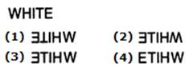
VISUAL REASONING
MIRROR IMAGE
In this question you are given a combination of alphabets and/or numbers followed by four alternatives (1), (2), (3) and (4). Choose the alternative which is closely resembles the mirror image of the given combination.
Q 24.

Slide 48
VISUAL REASONING
MIRROR IMAGE
In this question you are given a combination of alphabets and/or numbers followed by four alternatives (1), (2), (3) and (4). Choose the alternative which is closely resembles the mirror image of the given combination.
Q 24.

